Slide 1
Note-memory game
MTA20439
Notes:
Introduction

Slide 2
Group members
Martin Dahl Sørensen
Arijus Grotuzas
Julia Złotkowska
Marcus Hyttel
Gia Zveriachvili

Slide 3
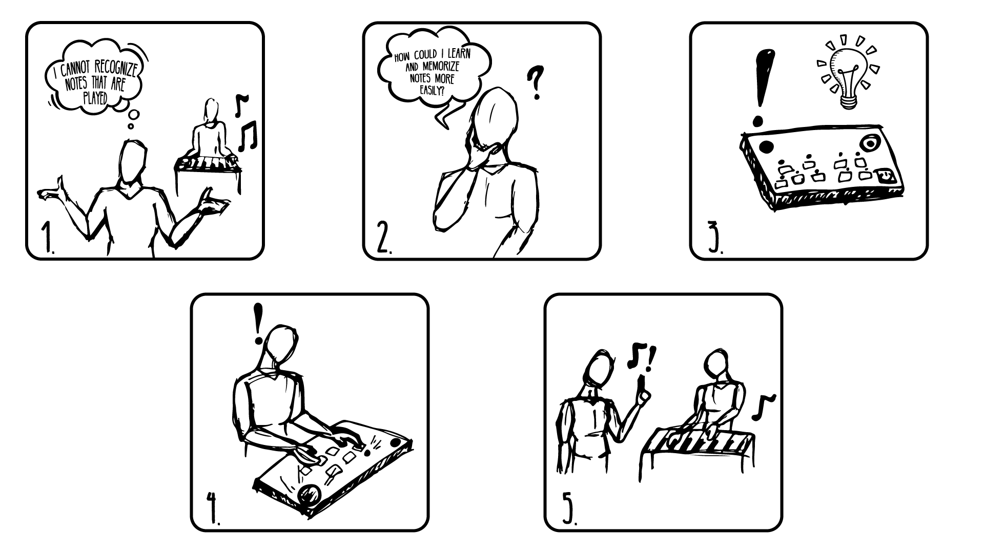
Storyboard
Notes:
Describe the storyboard

Slide 4
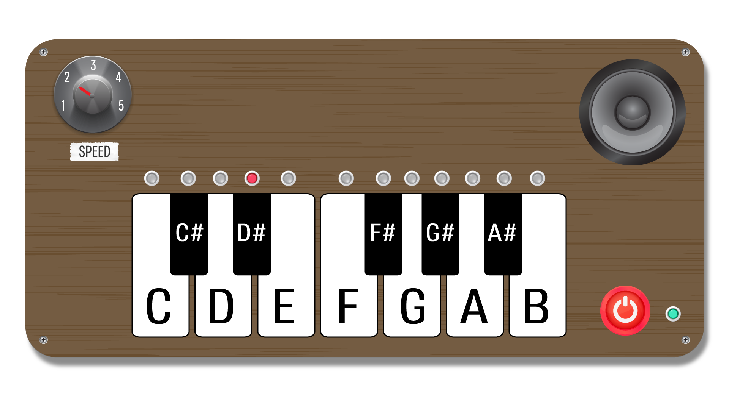
Notes:
Describe the design

Slide 5
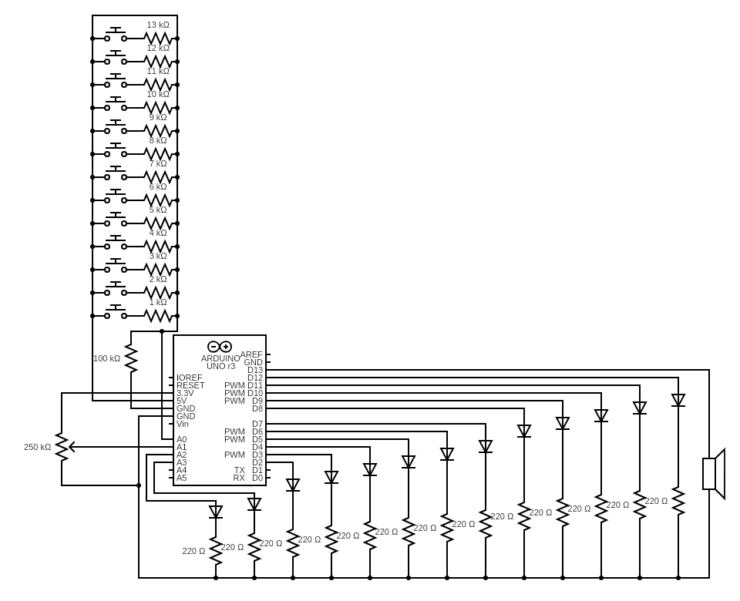
Circuit diagram
Notes:
Go over the used components, and reasons why we used it, and describe the circuit diagram (resistors)

Slide 6
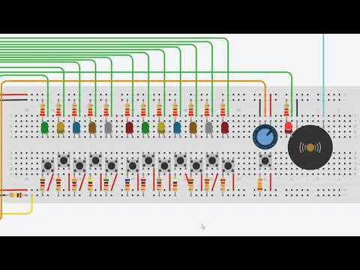
Demonstration of the prototype
Notes:
Play the demo video

Slide 7
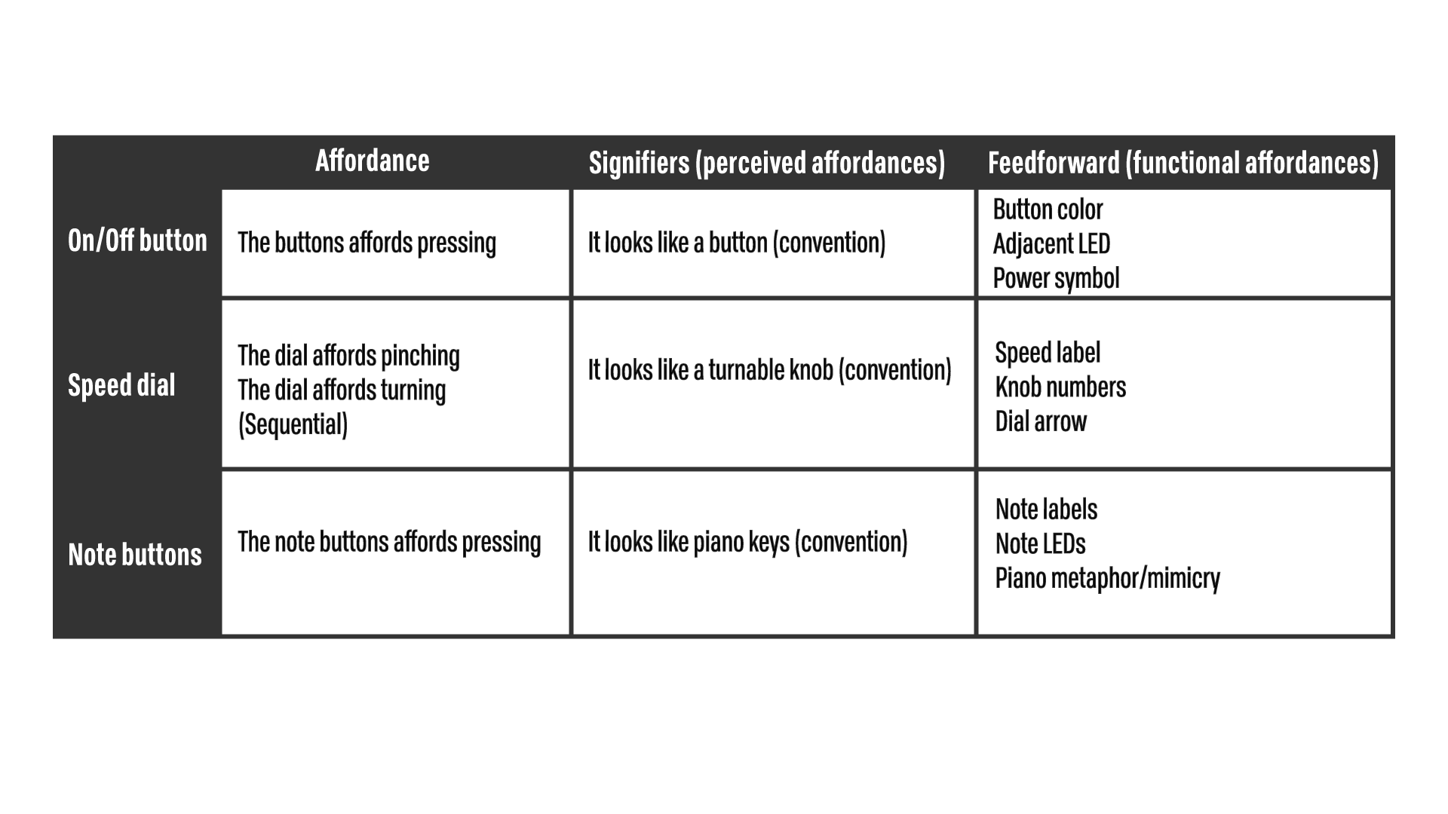
Affordance scheme
Notes:
Go over the table, describing each of the state, expectation from the testing?

Slide 8
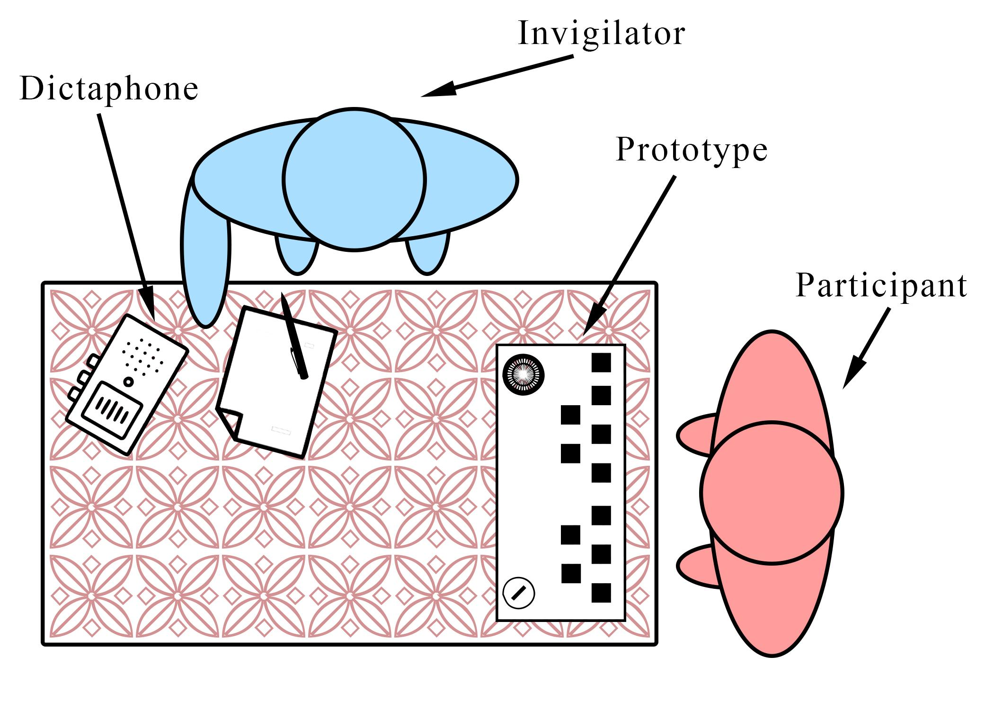
Mental model elicitation setup
Notes:
Go over the evaluation plan and the mental model

Slide 9
Evaluation results
On/ off button:
Feedforward: Functionality was clear
Feedback about its state was unambiguous
Perceived affordance matched up with the user’s mental model.
Speed dial:
Perceived affordance: Unclear function, misguide
Note buttons:
Feedforward: Easy to understand due to the piano tiles’ appearance and labeling of each note
Feedback: Understanding of the LED diodes lighting up when pressed, unclear about LEDs lighting up with the memory sequence
Suggestions to the future prototype:
Better labeling of speed dial to improve the understanding of its’ functionality
Additional labels for the note buttons LEDs

